Slide 1
TSM8-6.7 Validation of Portrayal Inputs
NIWC Atlantic
for
TSM8

Slide 2
Issues
How to constrain and validate user input to the portrayal?
Constrain: Limit the value domain available to the user
Disable inactive context parameters
Use enumerations to eliminate free-form input (when possible)
Validate: Ensure user-entered values are reasonable prior to further processing
Ensure input values are within the expected value domain
Ensure input values conform to an expected pattern (e.g. ###-####)
Ensure input values are logically consistent with respect to one another

Slide 3
Issues
How to provide user feedback on validation errors?
Indicate context parameter(s) which are source of error(s)
Supports a machine-readable UI implementation
Provide language-independent error message(s)
With optional icon
Supports a language-independent machine-readable UI

Slide 4
Research
UML: Object Constraint Language (OCL)
Provides constraint and object query expressions
example: a person is younger than their parents
context Person inv: self.parents->forAll(p|p.age > self.age)
XML: Schematron (XSLT)
Rule-based validation language which leverages XPath
Assert / Report
<assert test=“ContractDate &lt; current-date()”>Future contracts not allowed.</assert>
Extensible Application Markup Language (XAML)
Initialize structured values and objects
<Element1 IsEnabled=“{Binding ElementName=Element2, Path=IsChecked}”/>
Notes:
Mainly investigated concepts and their application to UI / input constraints
OCL: UML too abstract to apply to this problem
Schematron: provides basis of design
XAML: related to problem – designed to describe UI

Slide 5
Design Overview
Process and Implementation

Slide 6
Current Process
Context Parameter
Integer
String
Date
Double
Boolean
Portrayal Processing
Verify Input Conforms to Specified Type
No Constraints
No Validation
Notes:
Validate to ensure input conforms to specified type

Slide 7
Proposed Process
Context Parameter
Integer
String
Date
Double
Boolean
Portrayal Processing
Validate
Constrain
Enumerate
XPath 1.0 Expression
Regular Expression
Verify Input Conforms to Specified Type
XPath 1.0 Expression
Enable
Notes:
Enable
Enable or Disable the context parameter based on XPath expression
Constrain
Limit the value domain of the context parameter via enumeration
Validate (Assert / Report)
Validate the context parameters prior to portrayal input
Provide a report message on validation errors

Slide 8
Proposed Implementation: Overview
Update S-100 schema of portrayal catalog <parameter> elements contained within the <context> element
new attribute: enable
new elements: constrain, validate
Leverage XPath 1.0 and regular expressions to
Disable inactive context parameters
Provide validation rules
Provide machine-readable, language-independent error messages
With optional icons
Supporting consistent UI implementation
Notes:
Why XPath 1.0 vice 2.0?
XPath 2.0 includes support for regular expressions but is not currently supported by popular browsers
S-100 Part 9 requires XPath 1.0 (via XSLT 1.0)
OEMs could use XPath 2.0 to implement regular expression support if desired.

Slide 9
Proposed Implementation: Overview
1. ECDIS uses provided enumerations to restrict user input
Combo boxes, etc.
2. ECDIS generates simple XML document encoding context parameter values <parameter1>value1</parameter1> <parameter2>value2</parameter2>
3. ECDIS determines enabled parameters
4. For each enabled context parameter
ECDIS processes validation rules and ensures all evaluate to true
Notes:
Document typically generated in memory

Slide 10
Why not use Schematron or XSLT?
Performance
Avoid adding (more) XSLT processing overhead to portrayal generation
Complexity
Both Schematron and XSLT produce a report (an XML document)
Must be described by an additional schema (e.g. SVRL)
Schematron file must be compiled to XSLT prior to use (typically)
Portrayal extensions needed to deliver / update the Schematron or XSLT file
No standard provision for language independence
(could reference a message similar to alert catalog)
No advantage over XPath
Notes:
Proposed solution leverages XPath, the main processing element of Schematron / XSLT
Schematron and XSLT have disadvantages relative to using XPath by itself

Slide 11
Design Details
Implementation and examples

Slide 12
Proposed Implementation: enable
Attribute on parameter or validate element specifying an XPath expression
Expression must evaluate to true or false
Used to conditionally enable a context parameter or validation rule
e.g. enable shallow contour and deep contour when two shades is false
If expression evaluates to false
Disable any corresponding UI component
Do not perform any associated validation
<context>
…
<parameter id=“XYZ” enable=“xpath expression”>
…
</parameter>
…
</context>

Slide 13
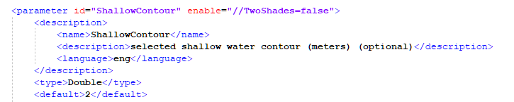
Example: Enable a context parameter
Sample input:
… <TwoShades>true</TwoShades>
<ShallowContour>2</ShallowContour>
<SafetyContour>30</SafetyContour>
<DeepContour>45</DeepContour>
Notes:
Shallow contour value enabled when TwoShades is false

Slide 14
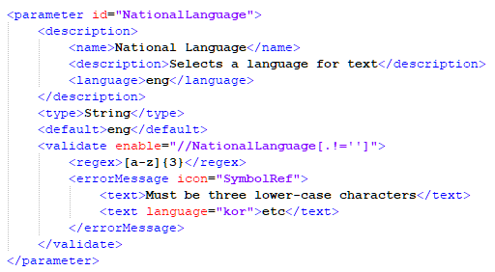
Example: Enable a validation
Notes:
Only validate if a value is provided

Slide 15
Proposed Implementation: <validate>
Provides a validation rule for a context parameter
Includes language-independent error message with optional icon
Validation Rule is either XPath or regex:
<xpath>expression</xpath>
XPath 1.0 expression which evaluates to true or false
Should evaluate to true prior to generating portrayal
<regex>expression</regex>
W3C XML Standard Part 2 Appendix F (Regular Expressions)
Should match prior to generating portrayal
Individual validation rules can be enabled / disabled via optional enable attribute as previously described
Notes:
OEMs could use XPath 2.0 to implement regular expression support if desired.

Slide 16
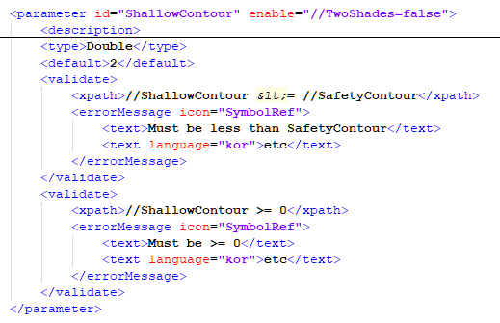
Example: XPath Validation
Notes:
Shows multiple validation rules
Language independent error message with optional icon

Slide 17
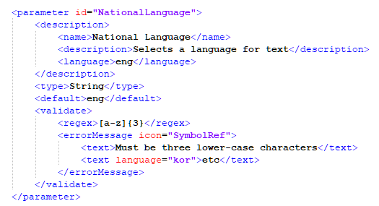
Example: Regular Expression Validation
Notes:
Optional icon
Optional language independent text label(s)

Slide 18
Proposed Implementation: <constrain>
Constrain a context parameter value to a set of enumerated values
Used to eliminate free-form input for any context parameter type
Can also be used to provide meaningful selection values
E.g. “Rock” vice “2”
Values are provided in <enumeration> elements
Language independent with optional icon

Slide 19
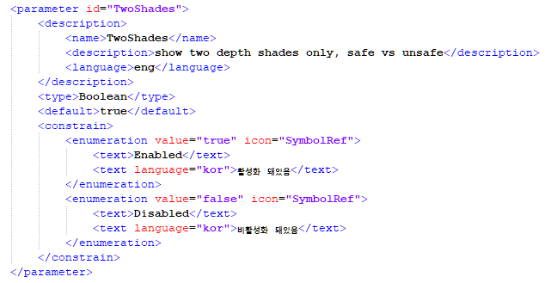
Example: Constrain
Notes:
Use “Enabled” and “Disabled” instead of “True” and “False”
Can be applied to any context parameter type
Optional icon
Optional language independent text label(s)
Could add enable attribute and validation element(s) to enumeration element to implement dynamic constraints (discussed later)

Slide 20
Schema
Additions and Changes

Slide 21
Schema Change: ContextParameter
<!-- Class for a context parameter -->
<xs:complexType name="ContextParameter">
<xs:complexContent>
<xs:extension base="CatalogItem">
<xs:sequence>
<xs:element name="type" type="ParameterType"/>
<xs:element name="default" type="xs:anyType"/>
<xs:element name=“constrain" type=“ConstraintType"/>
<xs:element name=“validate" type=“ValidationType"/>
</xs:sequence>
</xs:extension>
</xs:complexContent>
<xs:attribute name=“enable” type=“xs:string”/>
</xs:complexType>
Notes:
Will also add ConstraintType and ValidationType
May implement error messages using a type shared with the alert catalog
If so, error messages will reference catalog entries as is done in alert catalog

Slide 22
Schema Addition: ConstraintType
<xs:complexType name="TextType">
<xs:simpleContent>
<xs:extension base="xs:string">
<xs:attribute
name="language“
type="xs:string“
default="eng"/>
</xs:extension>
</xs:simpleContent>
</xs:complexType>
<xs:complexType name="EnumerationType">
<xs:complexContent>
<xs:sequence>
<xs:element
name="text“
type="TextType"/>
</xs:sequence>
</xs:complexContent>
<xs:attribute
name="value“
type="xs:anyType" use="required"/>
<xs:attribute
name="icon“
type="s100Symbol:IdString"/>
</xs:complexType>
<xs:complexType name="ConstraintType">
<xs:complexContent>
<xs:sequence>
<xs:element
name="enumeration“
type="EnumerationType"/>
</xs:sequence>
</xs:complexContent>
</xs:complexType>
Notes:
TextType: adds an optional language attribute to a string
EnumerationType: associates language independent text and an optional icon with a context parameter value
ConstraintType: specifies the enumerated values for a context parameter

Slide 23
Schema Addition: ValidationType
<!-- Class for a validation error -->
<xs:complexType name="ValidationErrorType">
<xs:complexContent>
<xs:sequence>
<xs:element
name="text“
type="TextType"/>
</xs:sequence>
</xs:complexContent>
<xs:attribute
name="enable“
type="xs:string"/>
<xs:attribute
name="icon“
type="s100Symbol:IdString"/>
</xs:complexType>
<!-- Class for a validation rule -->
<xs:complexType name="ValidationType">
<xs:complexContent>
<xs:sequence>
<xs:choice>
<xs:element
name="xpath" type="xs:string"/>
<xs:element
name="regex" type="xs:string"/>
</xs:choice>
<xs:element
name="errorMessage“
type="ValidationErrorType"/>
</xs:sequence>
</xs:complexContent>
</xs:complexType>
Notes:
Will also add ConstraintType and ValidationType
May implement error messages using a type shared with the alert catalog
If so, error messages will reference catalog entries as is done in alert catalog

Slide 24
Summary
Supports validation of inputs to S-100 portrayal rules
Standards compliant
Supports best practices
Performant
Simple implementation
Enhances portrayal robustness
“The ability to withstand or overcome adverse conditions or rigorous testing.”
Enhances security
First line of defense against code injection techniques
Notes:
Best practices dictate performing input validation prior to processing
Performant: fast and effective

Slide 25
Limitations
Can’t use validation of one parameter to affect other parameters
Stateless – no defined priority / order of evaluation
Order of evaluation is implementation dependent
Duplicate validation rules in multiple parameters to achieve same effect
Minimal support for context parameter type: Date
No support for S-100 truncated or recurring dates
XPath 1.0 does not support date comparison
Simple numeric comparisons can be supported
Validate to a specific format (e.g. YYYY-MM-DD), portrayal rule converts to a number
Note: date dependent portrayal does not require context parameter(s)
No portrayal registry support (S100_PR_ContextParameter)
Because validation rules may be product specific, but context parameters are not
Notes:
Date support could be extended in the future if a use case appears
via <xpath2> to indicate XPath 2.0 validation expression
via <date>: custom date validation expression (TBD, implemented by ECDIS)
Registering product specific validation rules with a context parameter precludes sharing the parameter across product types for synchronization

Slide 26
Actions
Prepare Change Forms
Present to Working Group

